Slide 1
Paper Review
Course Title: CSE424
Reviewer:
Name: Md. Asif Shahriar
Id: 20301328
Sec: 01

Slide 2
“Real Time Face Recognition Based Attendance System Using Multi Task Cascaded Convolutional Neural Network”
Authors: Vrushaket Chaudhari
Shantanu Jain;
Rushikesh Chaudhari;
Tanvesh Chavan;
Priyanka Shahane
Published in: 2023 International Conference on Emerging Smart Computing and Informatics (ESCI)

Slide 3
Introduction
The real-time face recognition based attendance system is a cutting-edge technology that uses a multi-task cascaded convolutional neural network to accurately identify individuals and record their attendance. This system offers numerous benefits and improvements over traditional attendance systems.

Slide 4
Real Time Attendance System
The Real Time Attendance System is a cutting-edge solution that utilizes face recognition technology to track and record attendance in real-time.
How it Works-
The system utilizes a multi-task cascaded convolutional neural network (MTCNN) to detect and align faces in real-time.
Once a face is detected and aligned, the system compares it to a pre-registered database of faces to identify the individual.
The attendance is then recorded in a centralized database, allowing for real-time tracking and monitoring.

Slide 5
Purpose of the system
The purpose of implementing this system is to streamline the attendance process, eliminate manual entry errors, and improve overall efficiency. By automating the attendance tracking process, the system saves time and resources for both employees and administrators.

Slide 6
Benefits of the system
Accurate and Reliable: The system utilizes advanced face recognition algorithms to ensure accurate identification of individuals, reducing the risk of errors and fraud.
Real-time Tracking: The system provides real-time attendance tracking, allowing administrators to monitor attendance data instantly and make informed decisions.
Efficient and Time-saving: By automating the attendance process, the system eliminates the need for manual entry, saving time for both employees and administrators.
Improved Security: The system enhances security by accurately identifying individuals and preventing unauthorized access to sensitive areas.

Slide 7
Face Alignment
Face alignment is the second stage of the MTCNN model. It normalizes the face by rotating and scaling it to a standard pose.

Slide 8
Face Recognition
Face recognition is the final stage of the MTCNN model. It compares the aligned face with a database of known faces to identify the person.

Slide 9
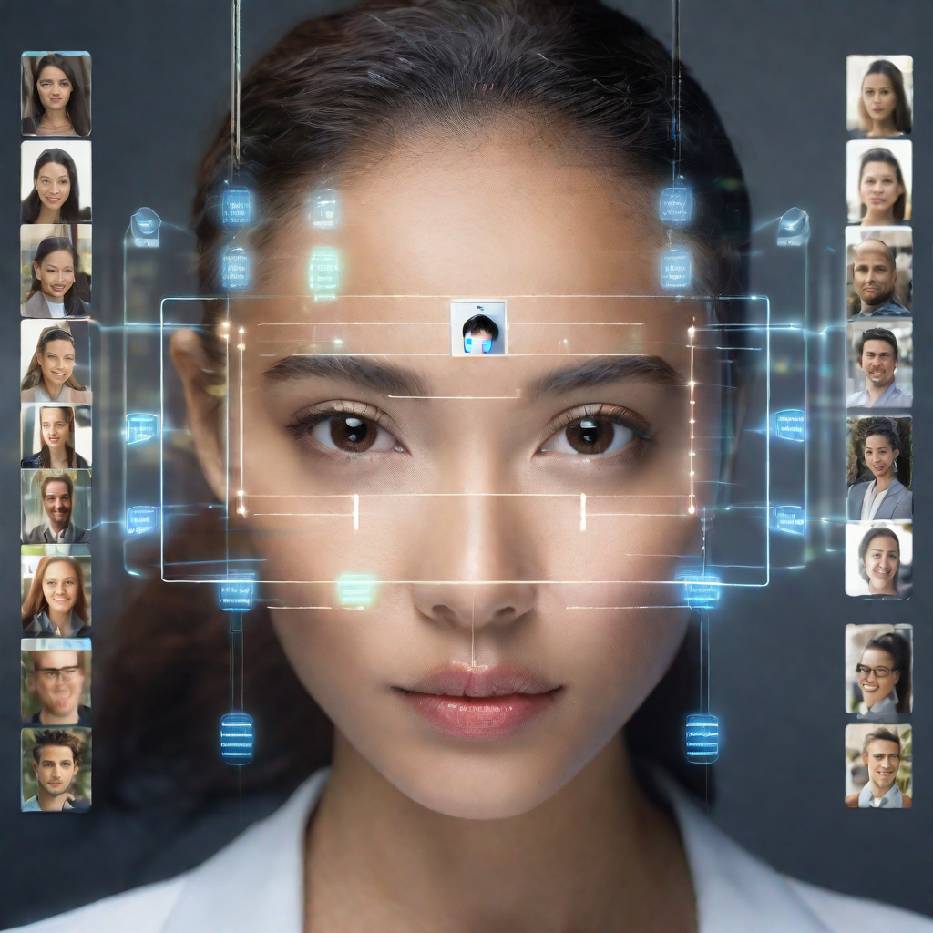

Attendance system using real time face recognition
The attendance system is designed to automatically record the attendance of individuals by recognizing their faces in real-time.

Slide 10
limitations
Accuracy and Reliability:
Achieving high accuracy can be challenging, especially in varying lighting conditions, different facial expressions, and with diverse demographic groups. False positives and negatives can impact attendance records.
Privacy Concerns:
Face recognition systems raise privacy concerns as they involve the collection and processing of individuals' biometric data. Ensuring compliance with data protection laws and regulations is crucial.
Hardware Requirements:
Real-time face recognition systems often require powerful hardware to process and analyze images in real-time. This could be a limitation in terms of cost and accessibility, particularly for smaller institutions or organizations with budget constraints.
Security Issues:
Face recognition systems may be vulnerable to spoofing attacks using photographs or videos. Implementing anti-spoofing measures is essential to enhance system security.

Slide 11
Challenges
Variability in Face Appearance:
Faces can appear differently due to factors like pose, illumination, and facial expressions. Designing a system that can handle these variabilities is a major challenge.
Real-Time Processing:
Achieving real-time processing for face recognition can be demanding. It requires efficient algorithms and powerful hardware to process and analyze images within tight time constraints.
Diverse Demographics:
Ensuring that the system performs equally well across diverse demographic groups (age, gender, ethnicity) is a significant challenge, as biases can be introduced during the training process.
Adverse Environmental Conditions:
Environmental factors such as low light, shadows, and occlusions can affect the performance of face recognition systems. Robustness to adverse conditions is a key challenge.
User Acceptance:
Some individuals may be uncomfortable with the idea of their facial data being captured and stored. Ensuring user acceptance and addressing concerns is crucial for successful implementation.

Slide 12

Real Time Implementation
The face recognition based attendance system can be implemented in real-time to automate the attendance process. Here are the technical details and requirements for real-time operation:

Slide 13
01. Multi-Task Cascaded Convolutional Neural Network (MTCNN)
The face recognition system utilizes the MTCNN model for real-time face detection and alignment. MTCNN is a deep learning-based algorithm that can accurately detect and align faces in images or video frames.
02. Real-Time Video Processing
To achieve real-time operation, the system must be capable of processing video frames in real-time. This requires efficient algorithms and hardware that can handle the computational load of face detection, alignment, and recognition.
03. High-Quality Camera
A high-quality camera is essential for capturing clear and detailed images of faces. The camera should have a high resolution and good low-light performance to ensure accurate face recognition in different lighting conditions.

Slide 14
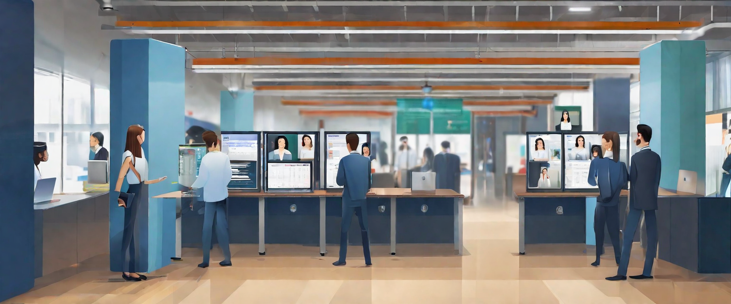
Conclusion
The real-time face recognition based attendance system using multi-task cascaded convolutional neural network is an efficient and accurate solution for attendance management.
It offers numerous benefits and has wide-ranging applications in different fields.

Slide 15


